Slide 1

Understanding mass movement of large bodies of hazardous Plant Emissions
James W Shinkle
Optical Scientific
Dr. Ting- Wang, Hsi-i Wang, Sung Kim, Donn Williams
Ashworth Leininger Group
Camarillo, CA

Slide 2
LOA Technology
  Developed by ERL/NOAA (Environmental Research Labs / National Oceanographic and Atmospheric Administration) in the 19070’s
  LOA technology simultaneously measures the average winds across the optical beam (crosswind) and the turbulence (CN2) over the measurement path
  Path Averaged wind sensors offer vast improvement compared to a single point wind sensor for large area wind studies
    LOA offers a more spatially representative measurement compared to a singe point measurement
  LOA technology is truly versatile instrument with great potential for many new applications where the behavior of large section of the atmosphere is of interest.

Slide 3
LOA technology Advantages
Path Averaged result (more representative)
Completely Eye Safe (can operate in public areas)
Portable sets up on special mounts and tripods
Easy to set up (hooks up to lap top)
Long-Range measurement (200 yards to 6 miles)
Modbus RTU or simple ASCII delimited data format
Powered by AC or DC (car battery) supply
Sensors can be placed in safe areas away from hazards

Slide 4
Installation details will depend on each site
LOA measures crosswinds up to 10 km
A single LOA measures bi-directional cross winds
Two LOA’s set up in an x pattern will give you both the X axis and Y axis so you can measure the magnitude and wind direction of the wind vectors
Three LOA’s can form an equilateral triangle around the area of concern and account for the movement of the air in that large space
Use retroflectors on towers/stacks to measure vertical profiles
Shoot LOA beams from buildings, out windows or over water

Slide 5
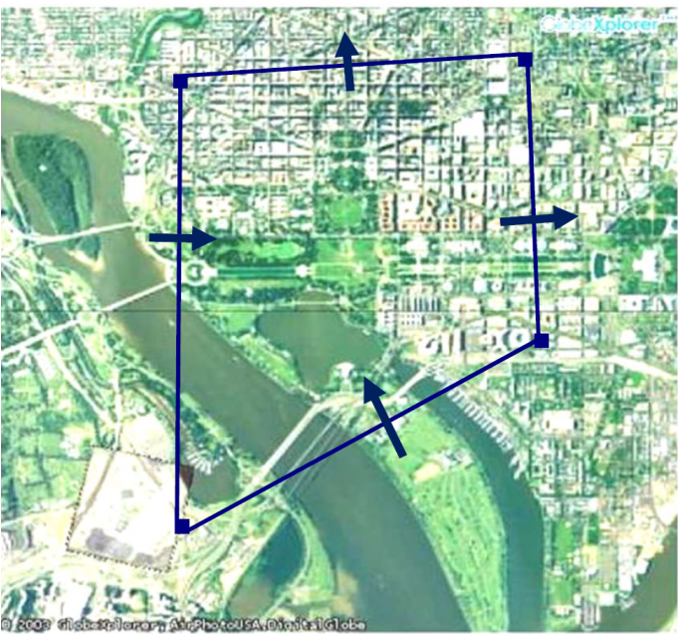
Surround Area of Concern
Use several LOAs to form an enclosed contour. At each lag, it will measure the cross-wind along the optical path.
By averaging the wind vectors on all sides, it will give the average 2-dimensional wind over a large area.
By measuring the convergence or divergence of all the winds measured at all the lags, it will give the near-ground vertical wind of the enclosed area.

Slide 6
LOA Technology Capabilities
  Micrometeorology: Convergence/Divergence – Diffusion Studies
  Obtain Two dimensional wind profiles
  Measure Up Drafts / Down Drafts
  Plume Dispersion
  Cross Winds
  Cn2 Strength (Turbulence)
  Microburst
  Vertical Profiles

Slide 7
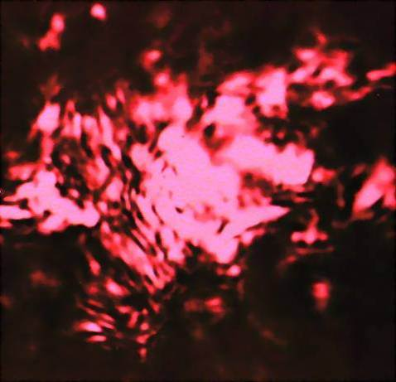
What is Optical Scintillation?
LOA technology is based on:
Optical Scintillation (Light Fluctuation)
Temporal cross-correlation (i.e. Time of Flight)
LOA uses a partially coherent LED and works by clocking the speed of shadows that pass by two detectors.
Diffusion of light
(Optical Scintillation)
Notes:
Scintillation is a general term; describes changes in apparent position or brightness of an object viewed thru the atmosphere.
Common example - twinkling of a star
Source: partially coherent LED whose diverging beam is passing thru thermal turbulence (hot & cold pockets of air)
Before passing thru turbulence, the image would look like a nice round spot.
After passing thru turbulence, nice smooth plane wave becomes distorted - instead of a round uniform spot, it looks like this…

Slide 8
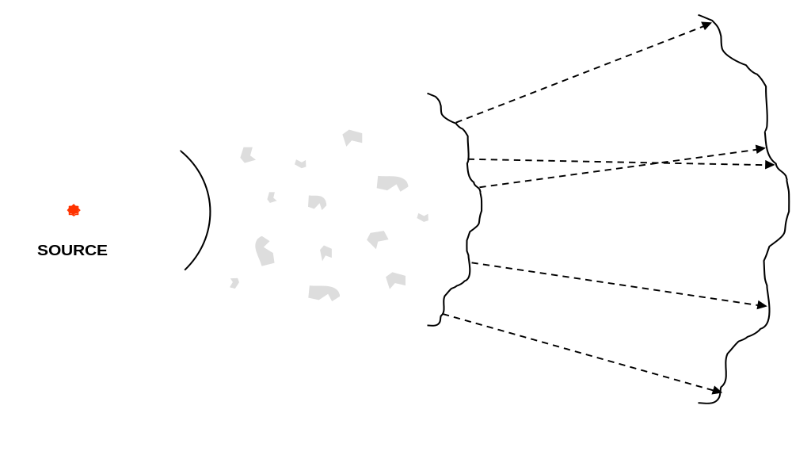
Optical Scintillation Technology

Slide 9
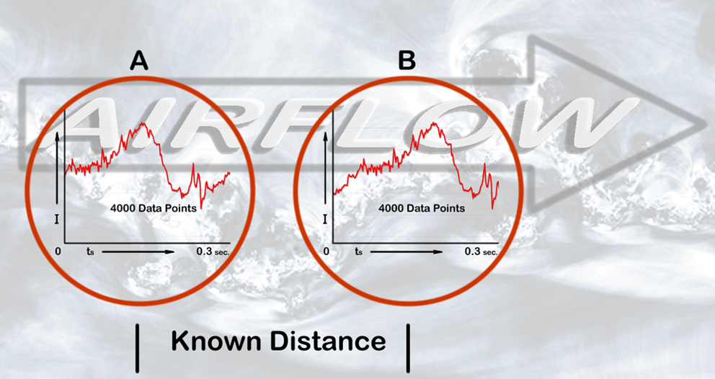
LOA digital processing
Detectors are Bi-directional
Notes:
Refractive index differences in the air flow cause shadows in the detector signals.
These light and dark patterns create a waveform shape or signature. This is the actual signal detected by the sensor.
Through a statistical correlation algorithm we measure the time it takes for the signature to travel from the first detector (A) to the second (B).

Slide 10
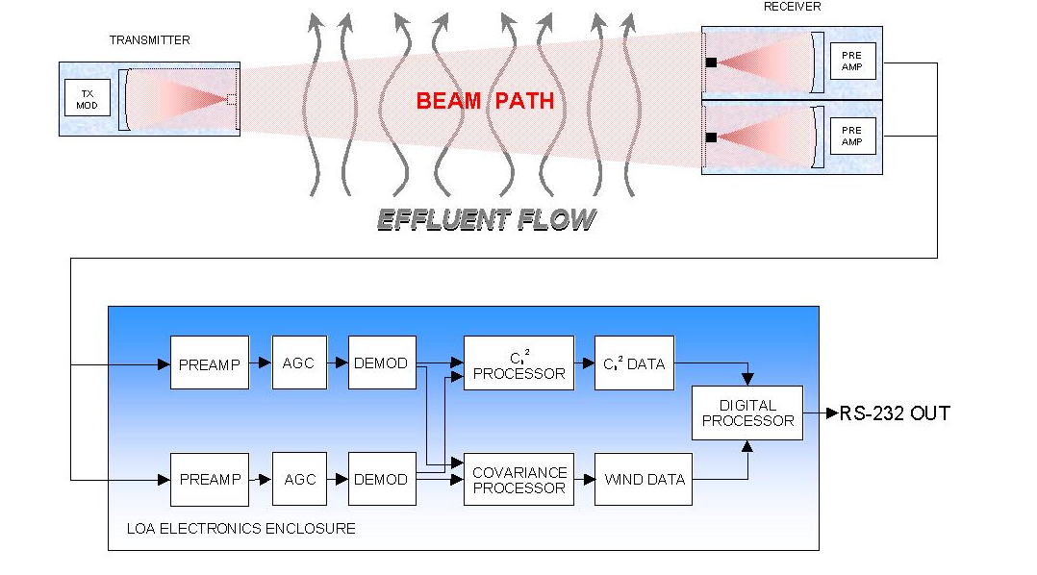
Optical Scintillation Technology

Slide 11

Successful Applications
LOA technology

Slide 12

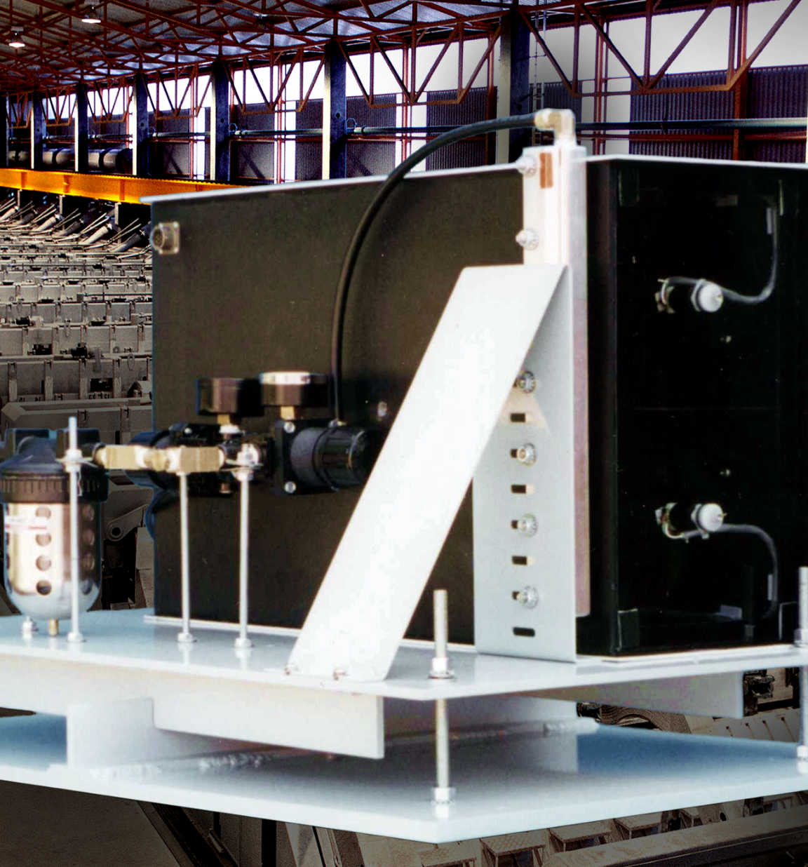
Aluminum Roof Vents
“Keep the sensor out of the harsh environment!
Spatially Averaged Measurement up to 3 Km
Not directly exposed to the effluent
EPA Method 14 Equivalency Approval
  LOA sensor designed to EPA standards
  LOA calibrator designed to EPA standards
  Continuous self test for light level and other parameters
  HF resistant polycarbonate windows
  Air purged housings
  Air knife built into Pneumatic & Alignment Apparatus

Slide 13
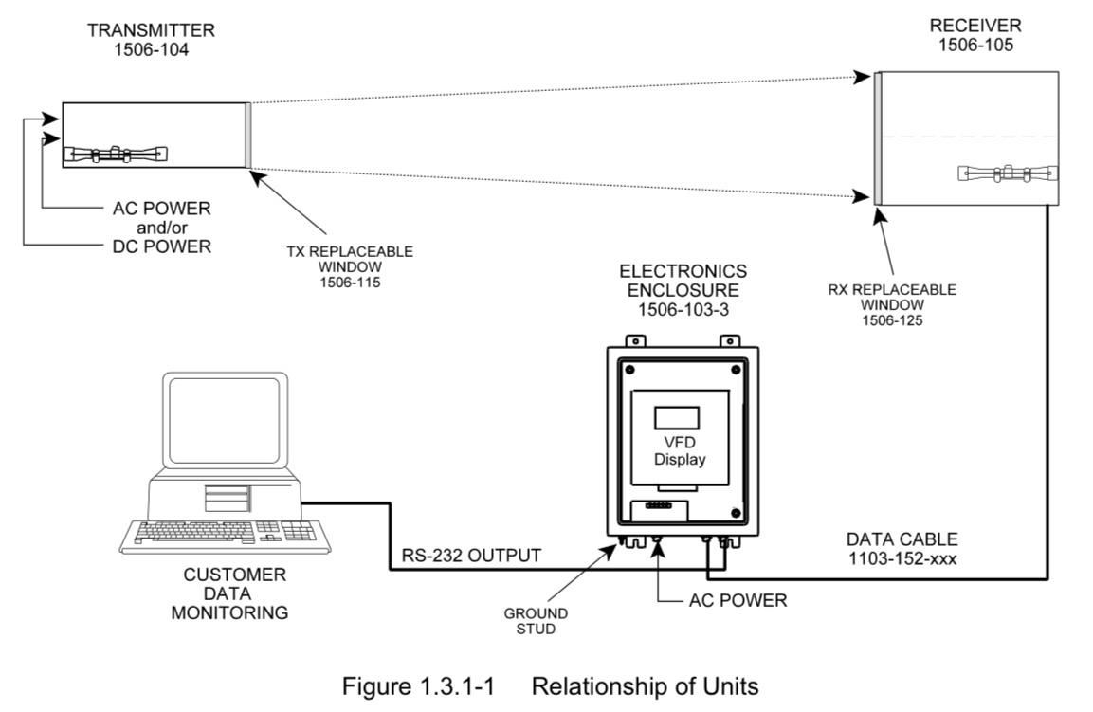

Slide 14
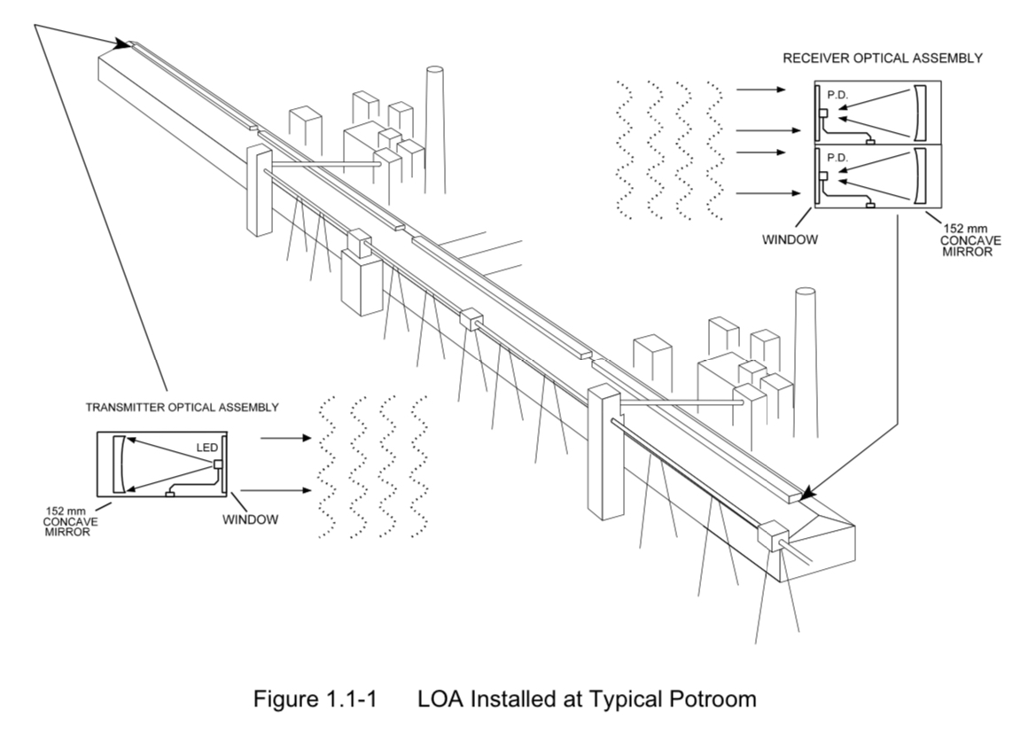

Slide 15
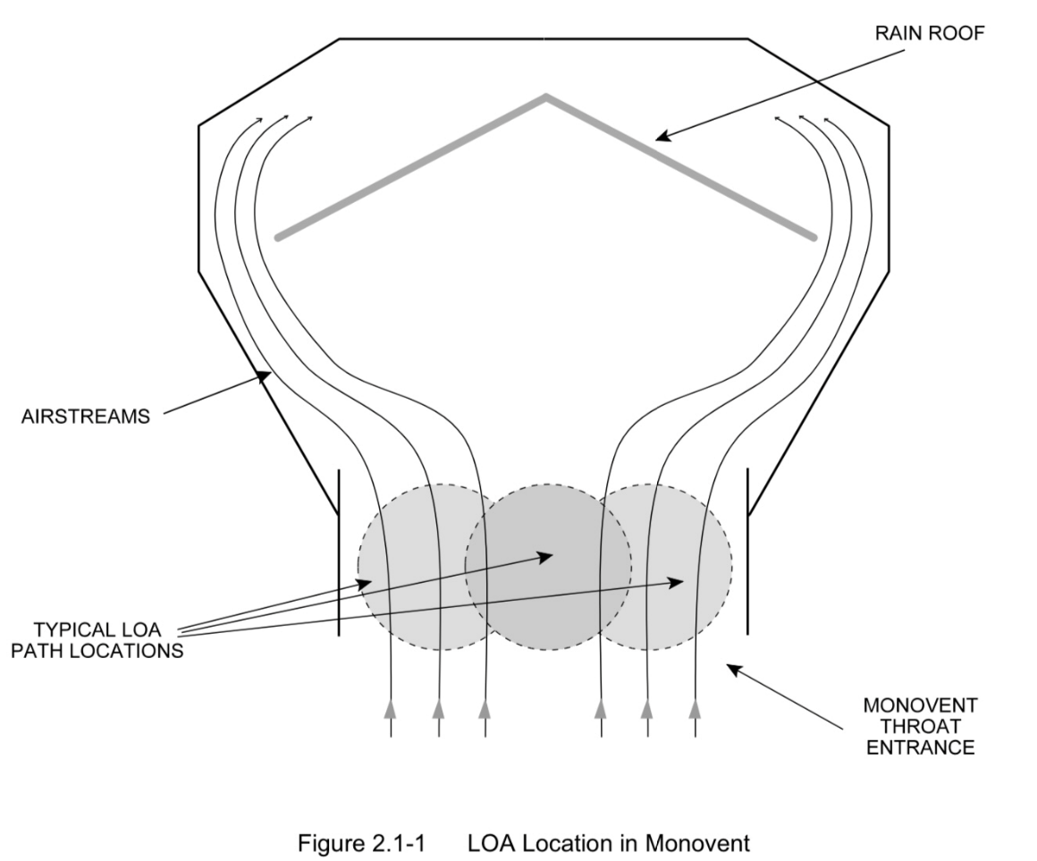
Potroom Monovent Location Guidelines
The LOA must be located in a section of the monovent throat that has representative airflow. Typical locations are shown in Figure 2.1-1.
Note that in these positions, the air streams are parallel to each other. The exact location depends on the geometry of the monovent.

Slide 16
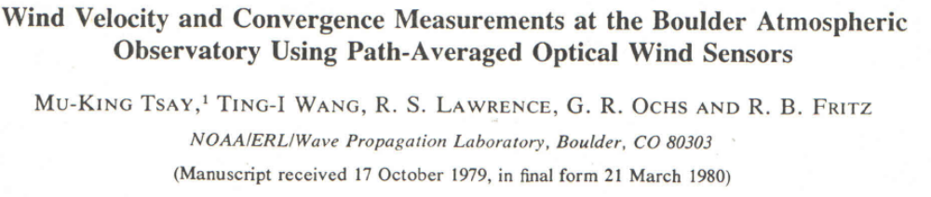
Path Averaged Wind

Slide 17
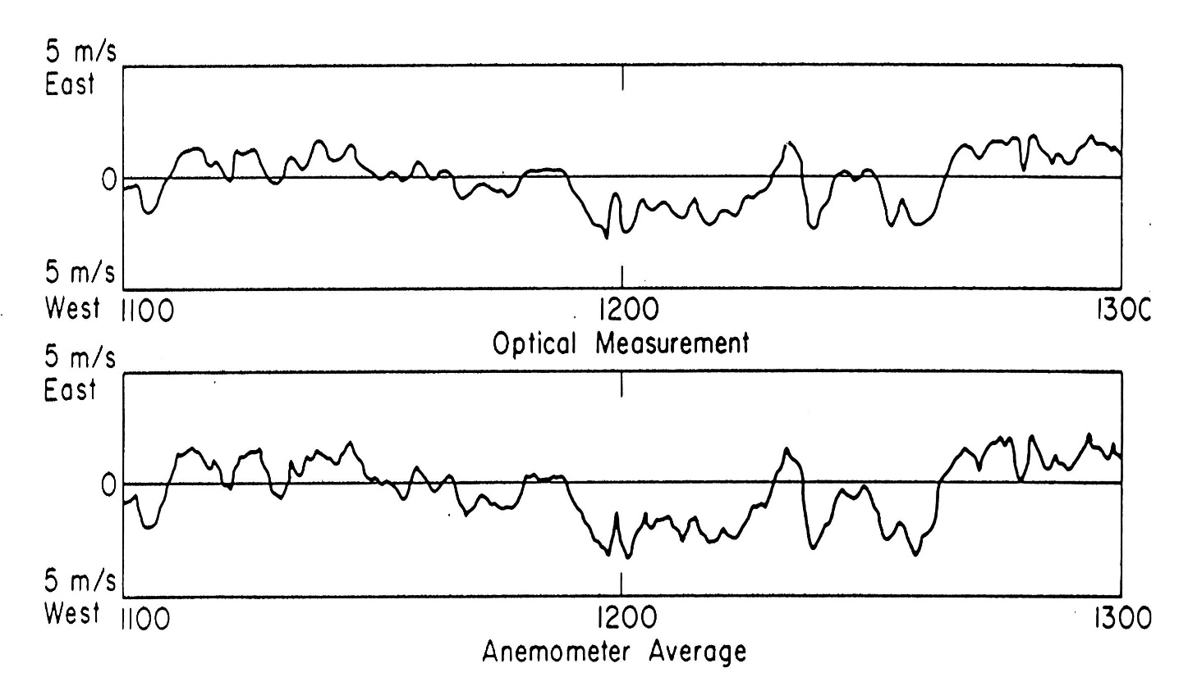
LOA - Test at Table Mountain Colorado
Notes:
Data in this slide shows a comparison of one LOA with 10 Anemometers along the optical path.

Slide 18
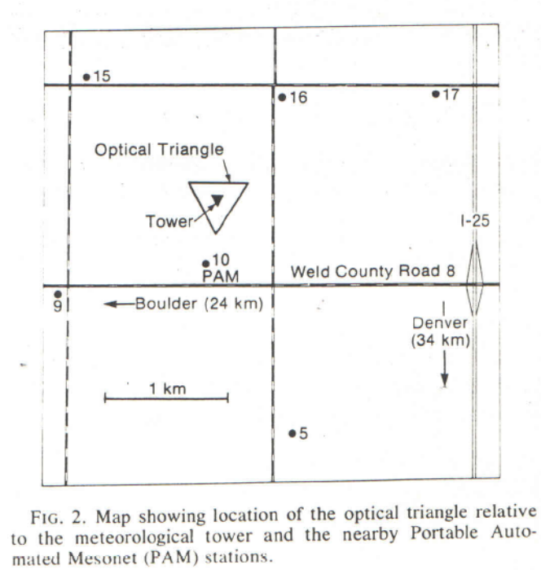
Optical Triangle, Met Tower, PAM stations
Meteorological Tower (300 M) is surrounded by an optical triangle of 3 LOA’s covering a 450 m equilateral triangle
PAM – (Portable Automated Mesonet) stations operated by National Center for Atmospheric Research. (Wind speed and direction, pressure, temperature, humidity and other parameters)

Slide 19
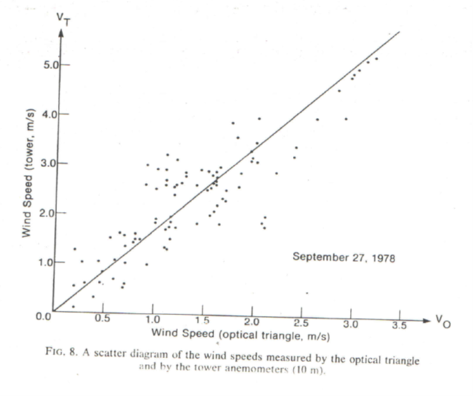
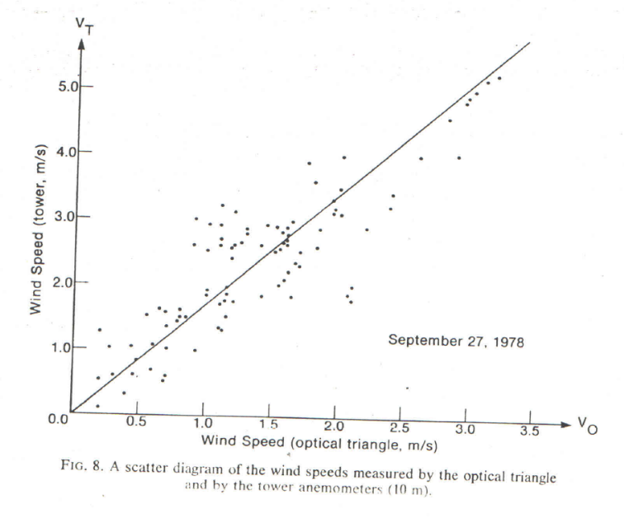
Wind Speeds of Optical Triangle
A scatter diagram shows there is a linear relationship (indicated by the solid line) between the two measurements

Slide 20
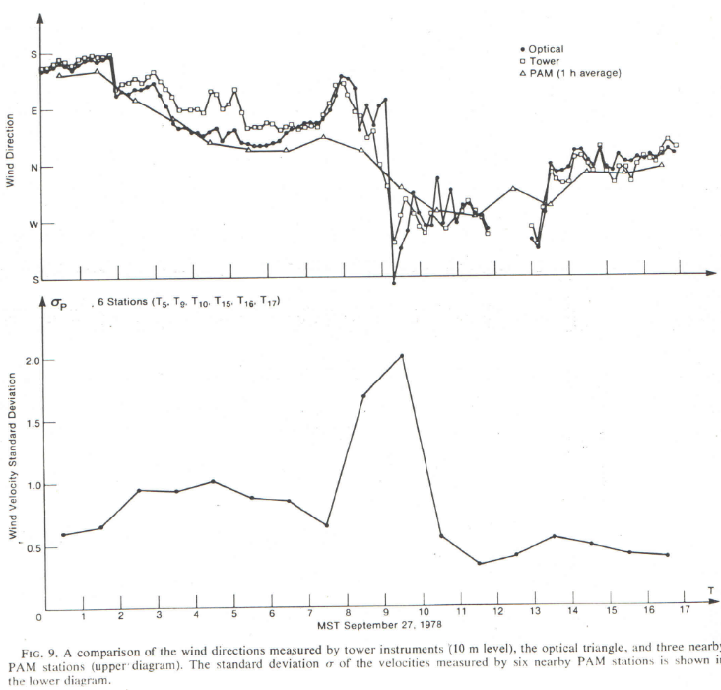
Horizontal Wind & Spatial Variation
The difference between the tower and the optical data becomes significant when the spatial variation of wind velocity is large.
Trying to study large bodies of air is difficult with a single met tower
LOA is an optical solution that covers a large area
Tsay, Wang, Lawrence, Ochs, & Fritz

Slide 21
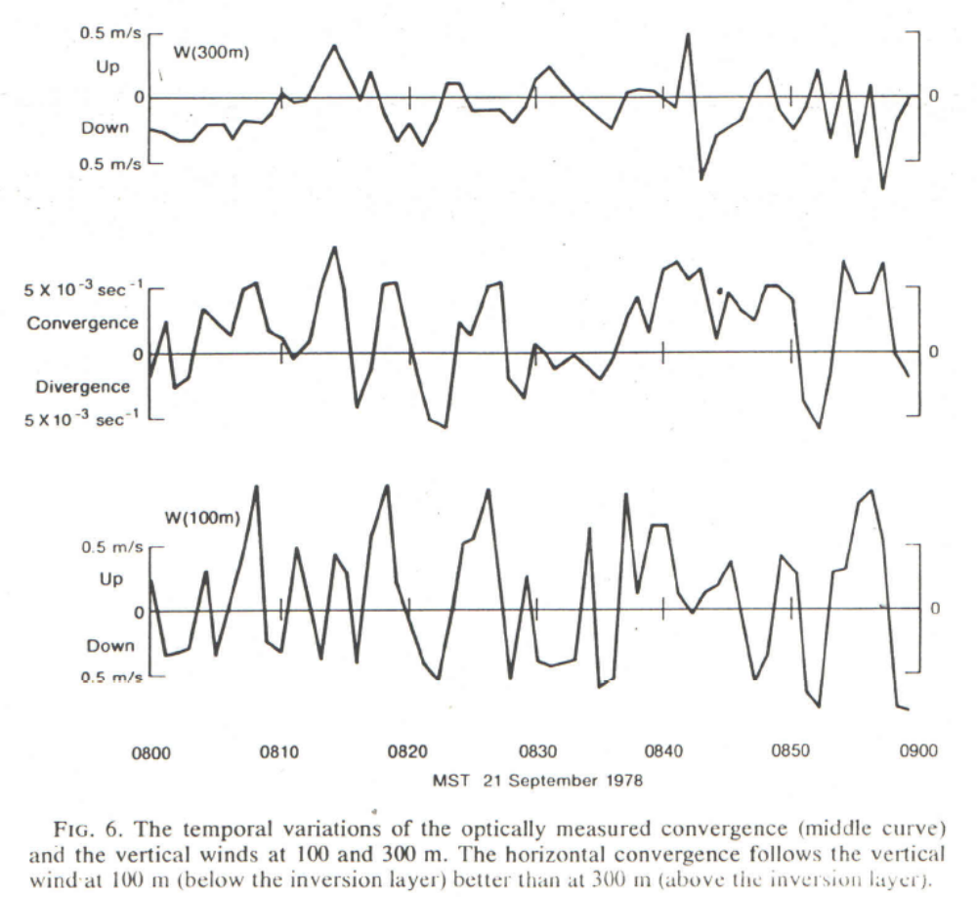
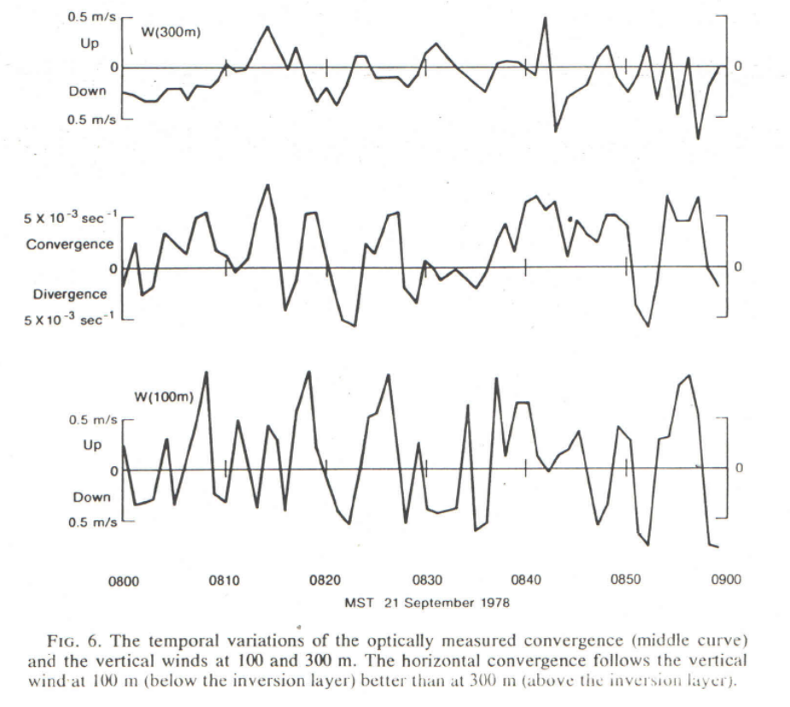
The Temporal variations of the optically measured convergence (middle Curve) and the vertical winds at 100 and 300 m. The Horizontal convergence follows the vertical wind at 100 m )below the inversion layer) better than at 300 m (above the inversion layer)

Slide 22
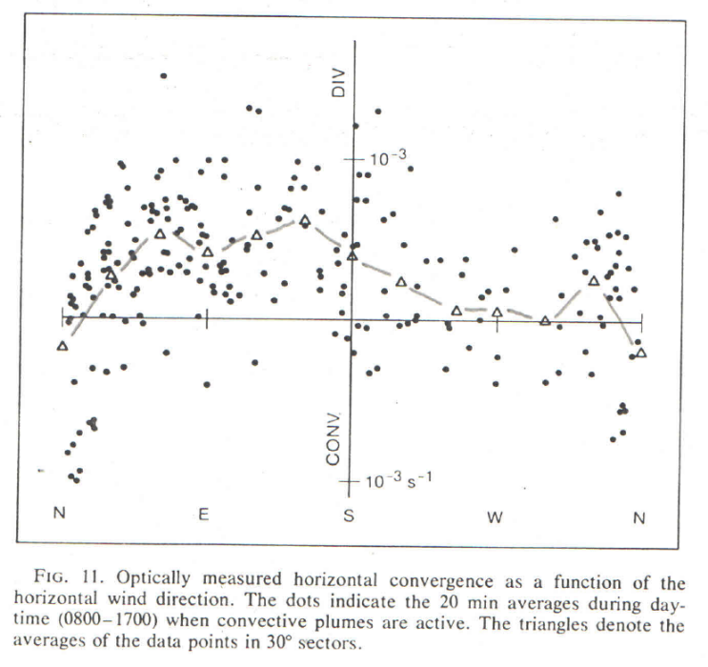
Optically measured Horizontal convergence
The dots indicate 20 min averages from (0800-1700) when convective paths are active
The Average of the data points in each sector is shown by the triangle
The wind direction bias seen is consistent with what we would expect from differences in height above the ground

Slide 23
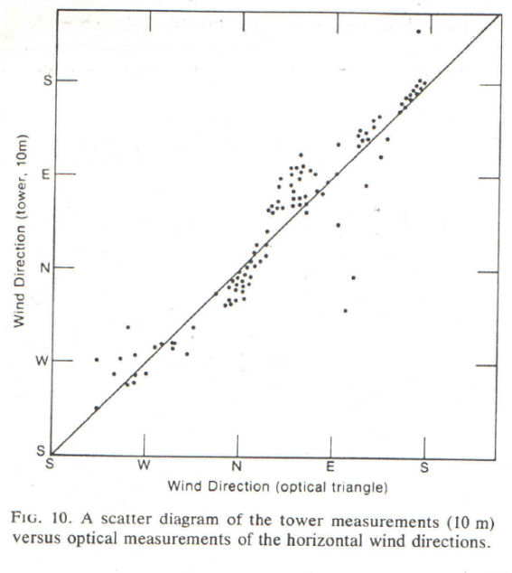
Horizontal Wind Tower vs Optical
Scatter Diagram of Tower measurements at 10 M verse Optical measurements of Horizontal Wind
The agreement is good but not perfect

Slide 24
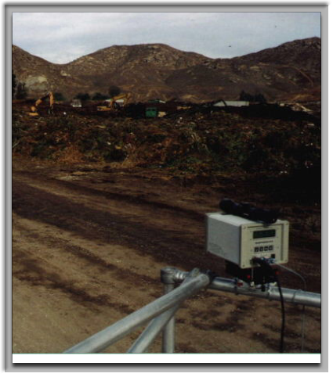
Inland Empire Composting site test using Optical Flow Sensor and Laser Based Open-Path Spectrometer
Direct method used LOA technology with Spectrometer to calculate mass emissions
Direct method showed lower mass emissions rate for NH3 and CH4
Winds are seldom constant
Test used two modified OFS flow sensors. One perpendicular one parallel to indicate when a significant change in wind happened

Slide 25

Cross and Parallel winds
At the start of the SCAQMD test, the wind was blowing to north at steady two to four feet per second. However, after about three hours the wind died down to zero. It stayed calm for an hour and then towards the end of the measurement period, wind reversed blowing direction altogether.
A major advantage of LOA technology is that it measures true cross wind averaged along the optical path. Therefore, the flux through the measurement path is not affected (even though the flux through other direction might change).

Slide 26
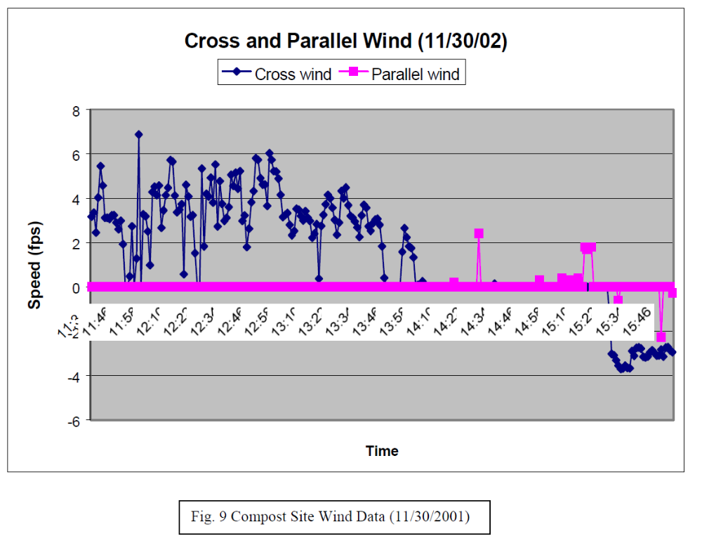
SCAQMD Wind Data

Slide 27
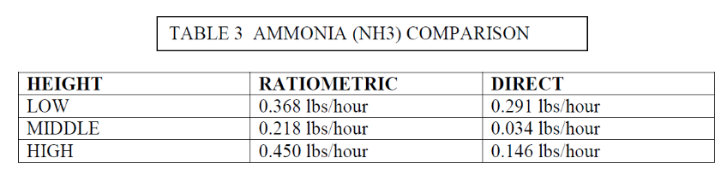
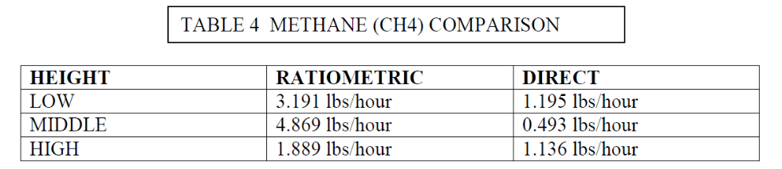
Inland Empire Composting site test using Optical Flow Sensor and Laser Based Open-Path Spectrometer
When compared with the wind data the source concentrations seam to be higher with lower wind speeds
The differences in the low level measurement was the wind was steady.
During the middle time, the wind was zero most of the time so spiking effects the radiometric method measurements
The Rate of VOC gases dispersion will depend upon the wind. During low wind conditions the gas can not disperse so the gas concentrations can build up
Sung Kim, Ting-I Wang

Slide 28
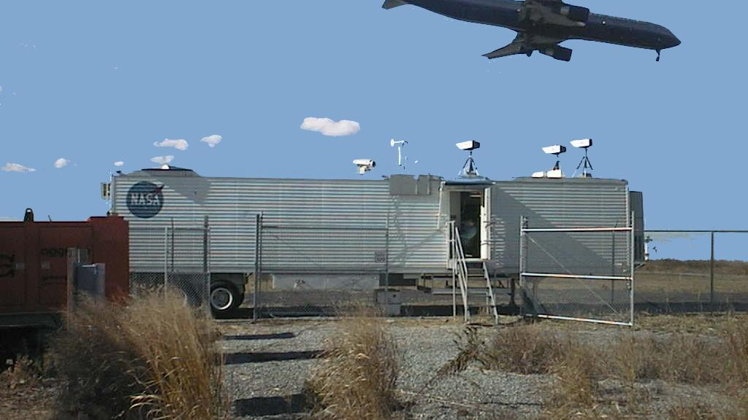
LOA – Setup at JFK International Airport

Slide 29
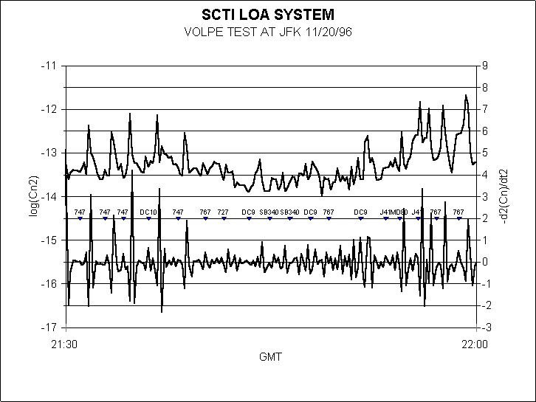
WAKE VORTEX STUDY

Slide 30
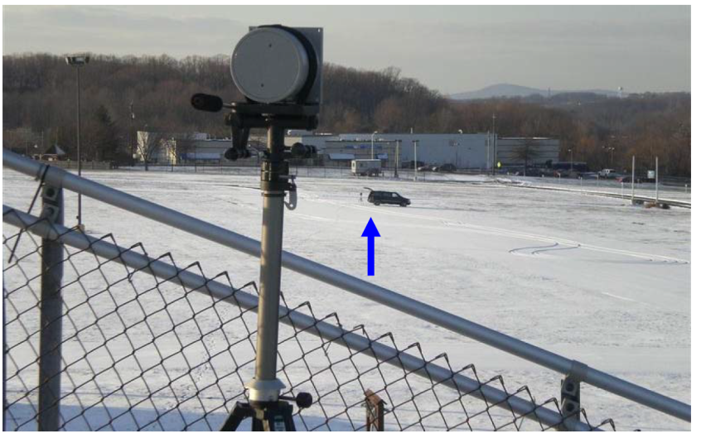
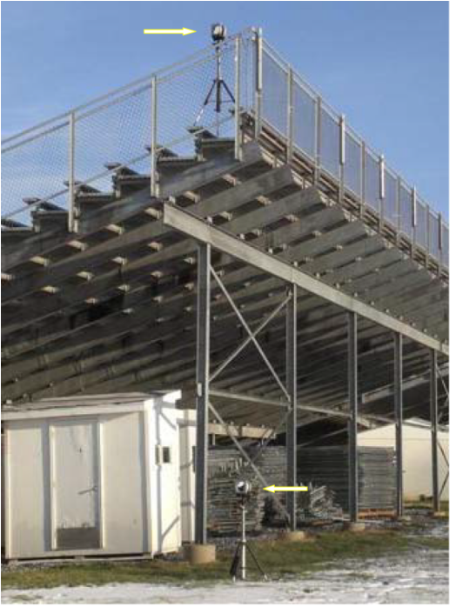
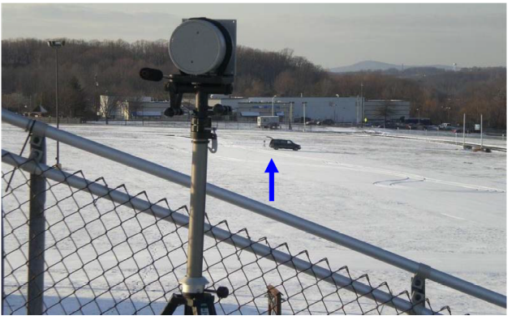
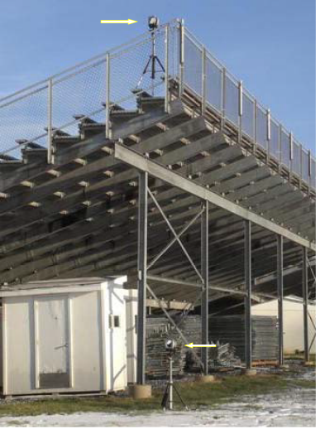
Obtaining Vertical Profiles
12 M above the Ground
Optical Transceivers 220 M away
1.5 m above the ground
Retroreflectors

Slide 31
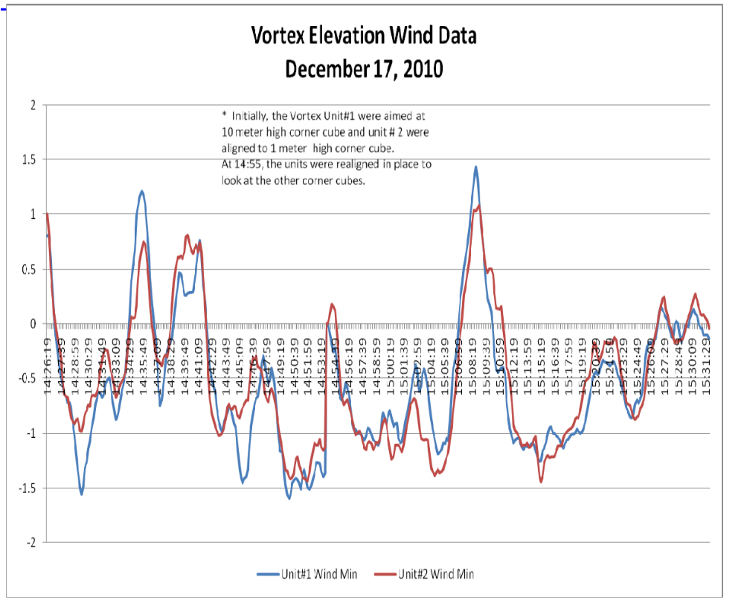
The agreement of the Crosswind at higher and lower paths indicate that crosswind is not as sensitive as the Cn2

Slide 32
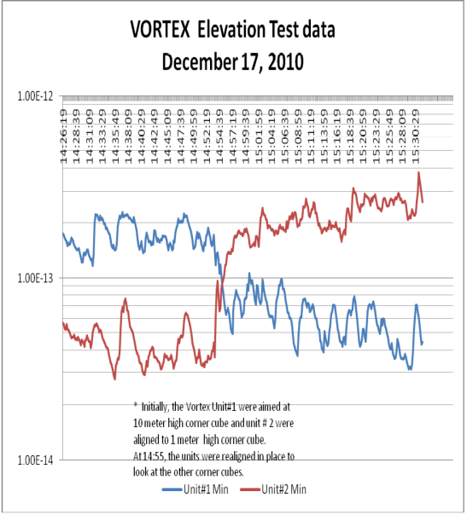
Turbulence Cn2 Data
Initially, Unit #1 (red-line) was aimed at the upper retro-reflector and Unit #2 (blue-line) was pointed to the lower retro-reflector.
The results indicated that the higher path (red-line) measure Cn2 is about a factor of 4 to 5 lower than the lower path (blue-line).
The two units were switched to look at the other retro-reflectors..
The measured Cn2 is also switched. This demonstrated that the measured Cn2 is not dependent on the special unit but related to the height of the path. Usually, higher path provides lower the Cn2.

Slide 33
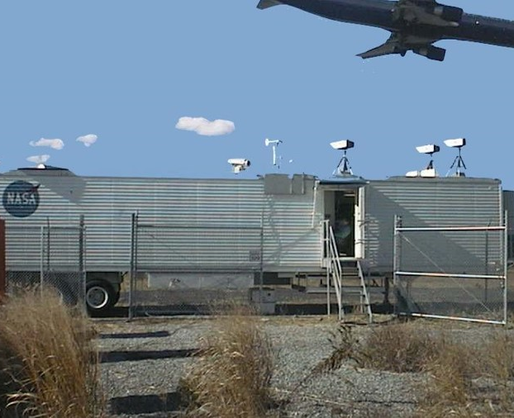
LOA Conclusion
The space averaged horizontal wind velocities can be obtained from the wind measurements of the three sides of the triangle.
These Space averaged measurements are more representative of the average wind than a few instruments in situ can be.
LOA which is an optical instrument can accurately measure the space averaged wind velocities over a large area.
LOA can account for the mass movement of hazardous air across a large area
Combine LOA with other sensors to better understand the mass movement of hazardous wind

Slide 34
LOA-105 users list
TRW
US Army Aberdeen Proving Grounds
Comalco – Bell Bay (Australia)
Air Fiber Inc.
ALCOA Europe Aviles (Spain)
ALCOA Europe La Coruna (Spain)
Kaiser Aluminum
ALCOA Badin ALCOA Rockdale Vanalco
ALCOA, Wenatchee
Reynolds Longview ALCOA Massena
University of Maryland
US Army Fort Belvoir Met Team
US Army Redstone Arsenal
Reynolds Massena
Defense Research Establishment (Canada)
US EPA Research Triangle Park
ALCAN Alma Canada
Naval Research Laboratory
Norsk Hydro (Norway) NASA Langley
ALCOA Baie-Comeau (Canada)

Slide 35
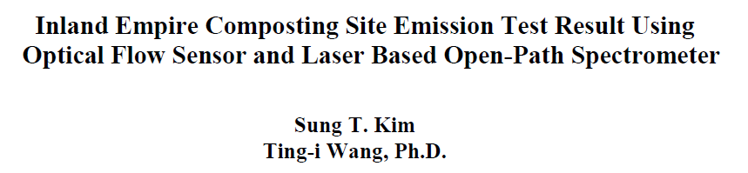
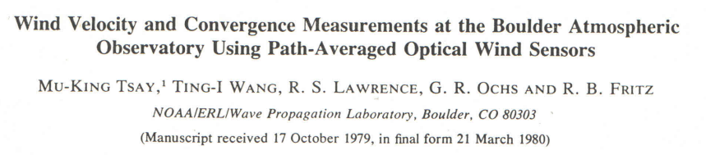
References

Slide 36
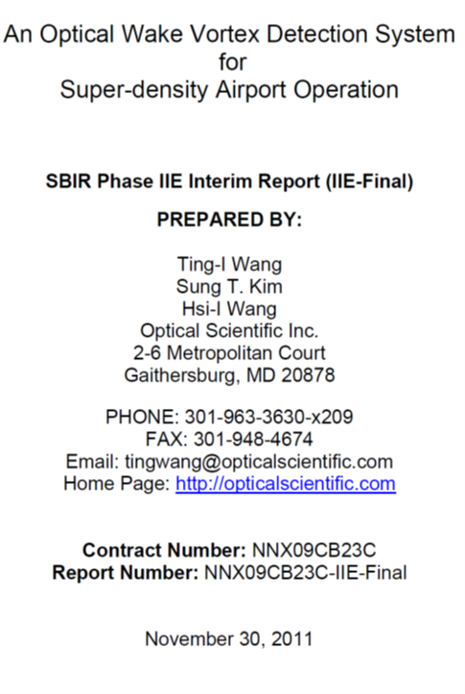
References

Slide 37
Questions Contact
James W Shinkle
Business Development
Jwshinkle@opticalscientific.com
Tel: 312-237-0375
2 Metropolitan Court, suite 6, Gaithersburg, MD 20878
TEL: 301.963.3630 FAX: 301.948.4674
e-mail: info@opticalscientific.com
web site: www.opticalscientific.com

